Slide 1
Processing Data on Air Pollution in Europe Using a Modern Data Platform
Piotr Slusarczyk
Notes:
Hello everyone,
I would like to present my project titled 'Processing Data on Air Pollution in Europe Using a Modern Data Platform.'
Today's presentation is centered on the significant challenge of air pollution in Europe.
I have dedicated time to exploring how a Modern Data Platform can leverage the vast amounts of air quality data collected by meteorological stations. My aim is to unravel patterns using the technology stack we've used throughout the course.
34’’

Slide 2
Air Pollution: Defining the Problem
Air pollution is causing significant health issues globally.
Nowadays, meteorological stations around the world collect air quality data.
How can we utilize this data to identify areas with unhealthy air?
Key Pollutants:
Particulate matter (PM2.5 and PM10) that can penetrate the respiratory system.
Nitrogen oxides (NOx) contributing to smog and acid rain.
Sulphur dioxide (SO2) from burning fossil fuels, leading to acid rain.
Carbon monoxide (CO), a toxic gas from incomplete combustion.
Ammonia (NH3) from agricultural activities and industrial processes.
Ground-level ozone (O3), a harmful air pollutant from chemical reactions in sunlight.
Notes:
Let’s address a serious concern: air pollution. It’s more than just a local environmental issue; it’s a health hazard on a global scale. With data from meteorological stations worldwide, the question is, how do we use it to identify high-risk areas for air quality?
Key pollutants to monitor include:
Particulate matter (PM2.5 and PM10) that invade our respiratory system.
Nitrogen and Sulphur oxides (NOx and SO2), the culprits behind smog and acid rain.
Carbon monoxide (CO), a deadly gas from incomplete fuel burning.
Ammonia (NH3) from farms and factories, and
Ground-level ozone (O3), formed by sunlight-driven chemical reactions.
Recognizing and measuring these pollutants is crucial for our health and environment.
51’’

Slide 3
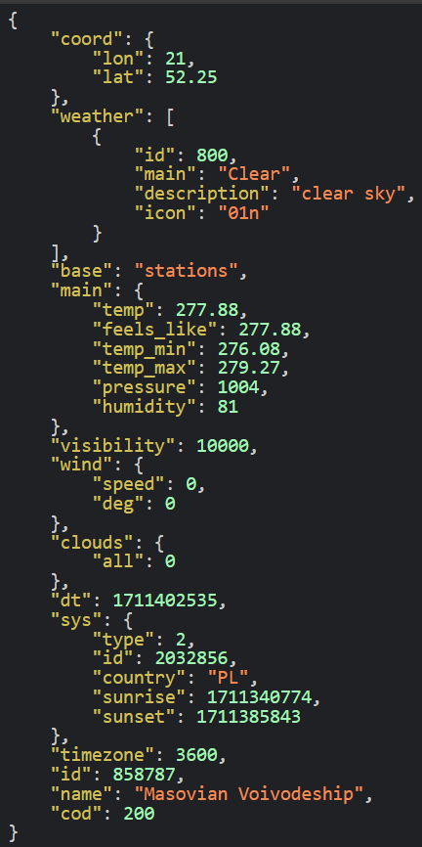
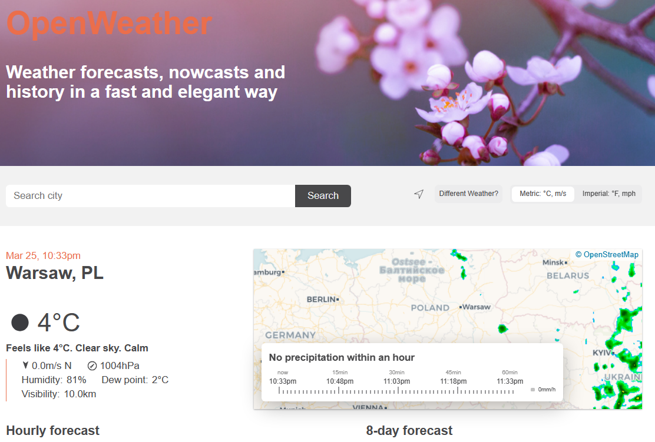
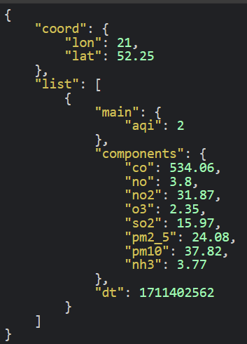
Data Source – Open Weather API
Notes:
Moving forward, let's talk about the primary data source for this project: the Open Weather API. This platform provides students, like us, with developer access, offering real-time weather forecasts, historical data, and current conditions through a sleek and efficient interface.
Specifically, I’ve utilized data from two distinct REST API endpoints: one for weather data and the other for pollution data. To give you a practical example, I've pulled live data for Warsaw, Poland—where I'm currently based. Here, you can see current weather conditions alongside pollution levels.
This API is crucial for gathering timely and accurate environmental data, which is the backbone of my analysis. Such detailed information allows us to not only track weather patterns but also monitor air quality in real-time, providing a rich dataset for our study.
62’’

Slide 4







Steps – Modern Data Platform
Ingest
Step 1
Extracting data from API,
copying CSV files for data enrichment.
Storage
Step 3
Saving data from Kafka consumer to a Delta table, storing CSV files in DBFS.
Processing
Step 4
In Spark: converting data to proper schemas and cleaning
Analysis
Step 5
In Spark: sorting, aggregating, determining coefficients.
Serving
Step 6
Storing data in Azure SQL Database, Displaying figures and maps in an Azure App Service application.
Streaming
Step 2
Streaming data from Azure App Service application through Kafka
Notes:
Let's examine the structured steps I followed using a Modern Data Platform to process and analyze our air quality data. This framework is designed to handle large-scale data efficiently and effectively.
Step 1: Begins with the extraction of data from the API. I created a Python application adn deployed it on Azure. Here, I also copy CSV files for subsequent enrichment.
Step 2: Involves streaming this data through a Kafka producer, in fact connecting with Azure Event Hubs.
Step 3: The streamed data is then saved to a Delta table. the CSV files are stored to the Databricks File System.
Step 4: Utilizing Apache Spark, the data is converted to adhere to proper schemas, and a cleaning process is performed to ensure the quality of our data.
Step 5: The cleaned data undergoes a series of analytical processes in Spark — this includes sorting, aggregating, and determining coefficients that are vital for our study.
Step 6: Finally, the processed data is stored in an Azure SQL Database. The results are then displayed using visualizations and maps in an Azure App Service application (the same that extracts and sends data), enabling us to interact with the data and extract meaningful insights.
This six-step process represents the pipeline of transforming raw data into actionable knowledge, ensuring that every stage adds value and brings us closer to understanding air pollution patterns in Europe.
81

Slide 5
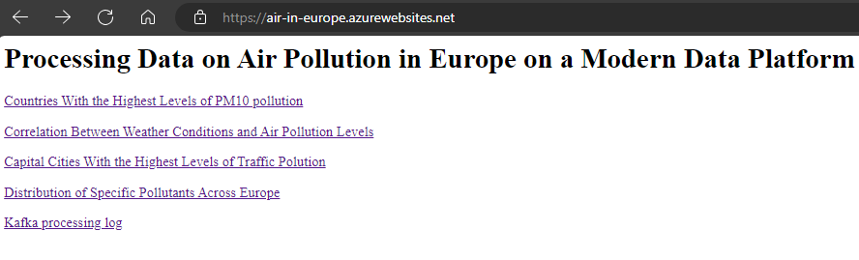
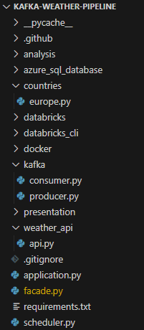
Ingest
Python Flask application deployed on Azure.
Scheduler reading data from the Open Weather API and sweeping the coordinates of Europe.
CSV files with coordinates of capital cities and ISO names of countries are copied to Azure through the Databricks CLI.
Notes:
In the 'Ingest' phase of the data platform, I initiate the collection and integration of data necessary for my air pollution analysis. The process unfolds as follows:
A Python Flask application has been deployed on Azure, serving as the backbone of our data collection mechanism.
This application is scheduled to regularly fetch data from the Open Weather API, sweeping through the geographical coordinates of Europe to collect a comprehensive dataset.
Additionally, CSV files containing the coordinates of capital cities and the ISO country codes are downloaded from the Internet. These files are needed to diplay the meaningfull names.
These collected datasets are then prepared for the streaming phase.
45’’

Slide 6

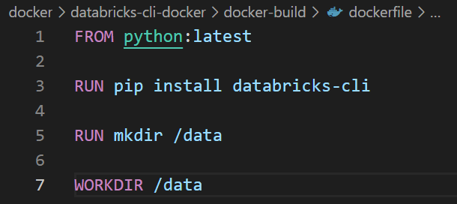

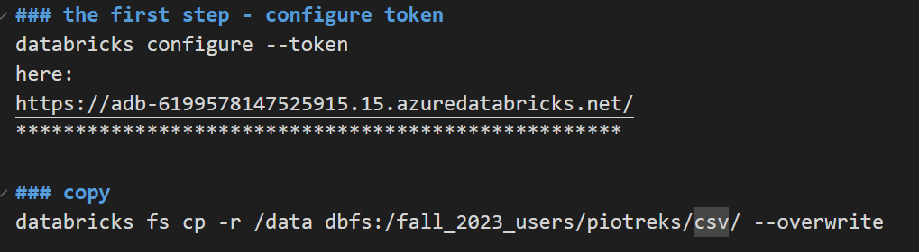
Storage - Creating a Docker container with Databricks CLI, Copying Files to Databricks.
1. Defining a dockerfile
5. The result
2. Creating an image
3. Running the docker container
4. Copying to Databricks
Notes:
In this section of the presentation, I'm going to walk you through the process of creating a Docker container equipped with Databricks CLI for the purpose of transferring files efficiently to Databricks.
I began by defining a Dockerfile. This file is a blueprint for Docker, describing the environment needed to run Databricks CLI. It's based on a Python image, installs the Databricks CLI, and sets a working directory.
Next, I created an image from the Dockerfile. The command shown on the slide builds the Docker image, which contains all the necessary components to run the Databricks CLI.
Once the image was ready, I proceeded to run the Docker container. This step involves executing a Docker run command, which initiates a container instance where I can execute Databricks CLI commands.
The fourth step was to copy the CSV files to Databricks. To do this securely, I first configured access to Databricks using a token. This ensures that the connection to Databricks is secure and that only authorized commands are executed. Once the token was configured, I used the Databricks CLI to copy files from the local data directory to the Databricks file system, replacing any existing files with the same name.
The result, which you can see on the right, is the list of files successfully copied to Databricks.
80’’

Slide 7
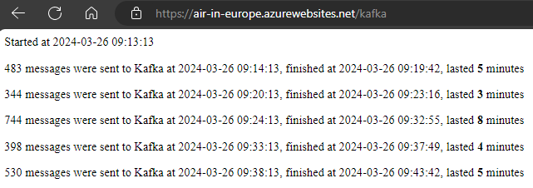
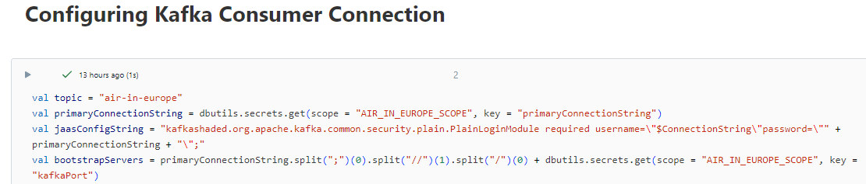
Streaming
A Kafka producer written in Python that sends the raw data regularly to Azure Event Hubs
Producer, scheduler, and application log components are deployed on the same Azure Flask application.
A Kafka consumer implemented on Azure Databricks
Notes:
In the streaming stage, I handle the real-time flow of data. The core components of this stage are:
A Kafka producer, which is a Python application I wrote, using proper libraries. It's responsible for sending the raw data at regular intervals to Azure Event Hubs.
To manage this process, I've set up a scheduler and the application's simple logging system, all of which run on the same Azure Flask application.
The logs on display here show the Kafka producer in action, indicating the timestamps and counts of messages sent. It demonstrates the system's continuous operation.
The second critical component is a Kafka consumer, which I've implemented on Azure Databricks. This consumer processes the incoming data stream, making it ready for analysis and storage.
This slide provides the configuration code for the Kafka consumer, illustrating how we connect and configure the data consumer within the architecture.
54’’

Slide 8

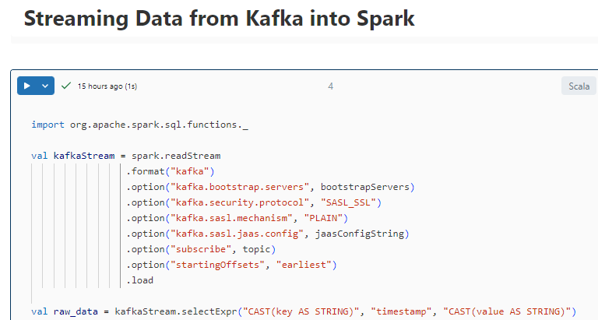
Streaming
Reading the stream from the beginning.
Converting the key and value to strings.
Notes:
Continuing with the streaming stage, let’s focus on how the data is handled within Spark. The two main tasks at this point are:
Reading the stream from the beginning, ensuring no data is missed and that we have the full picture of the air quality over time.
Converting the key and value in the Kafka stream to strings to standardize the data format for subsequent processing.
On this slide, you see a snippet of the actual code used in the streaming process.
It sets the options for the Kafka stream, including the servers, security protocol, and subscription details. The 'startingOffsets' is set to 'earliest', which tells Spark to begin processing records from the earliest available in Kafka.
44’’

Slide 9
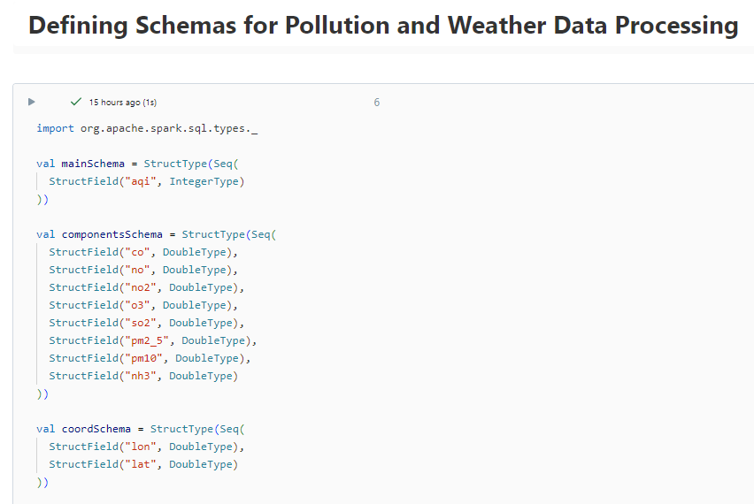
Processing
…
Notes:
Now, we arrive at the 'Processing' phase, where defining precise schemas for the data is essential.
Schemas are blueprints that describe the structure of the data we expect in the system. They enable Spark to parse and process data in a consistent and optimized manner.
It's important to note that the schema shown is not complete due to its length, but it gives an insight into how I prepared my data for reliable analysis.
28’’

Slide 10
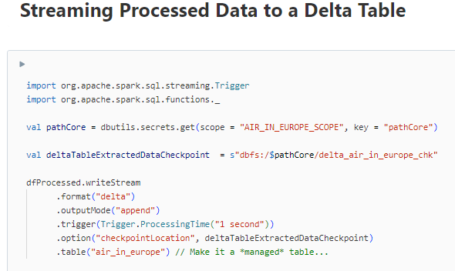
Storage (again)
Notes:
We're revisiting the 'Storage' step, this time to talk about streaming the processed data into a Delta Table.
The code shown here handles the streaming process. It's set up to append data to the table in real-time, with checkpoints that maintain the data's integrity.
I've used the Databricks CLI to create a secret scope, which securely manages the storage paths, vital for protecting sensitive information.
25‘’

Slide 11
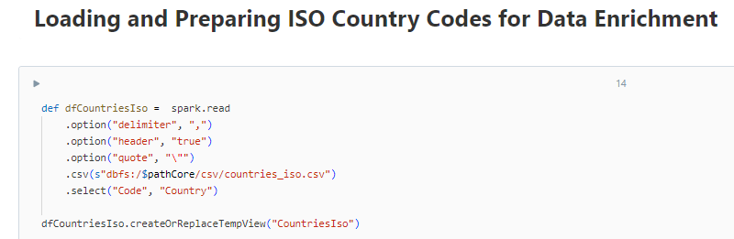
Processing
Notes:
"In this part of the Processing phase, we're enhancing our dataset with essential reference information. Specifically, I'm loading ISO country codes, which are crucial for data enrichment.
The code displayed here uses Apache Spark to read a CSV file containing the country codes. The options set within the code ensure that the CSV file is read correctly, considering headers and custom delimiters.
After loading, I create a temporary view of this data within Spark. This view, 'CountriesIso', allows me to efficiently join the country codes with our main dataset, enriching it with standardized country information.
39‘’

Slide 12
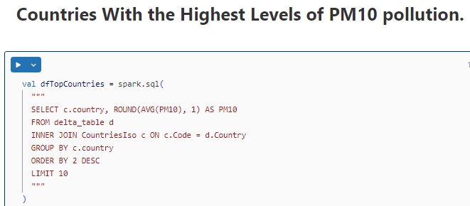
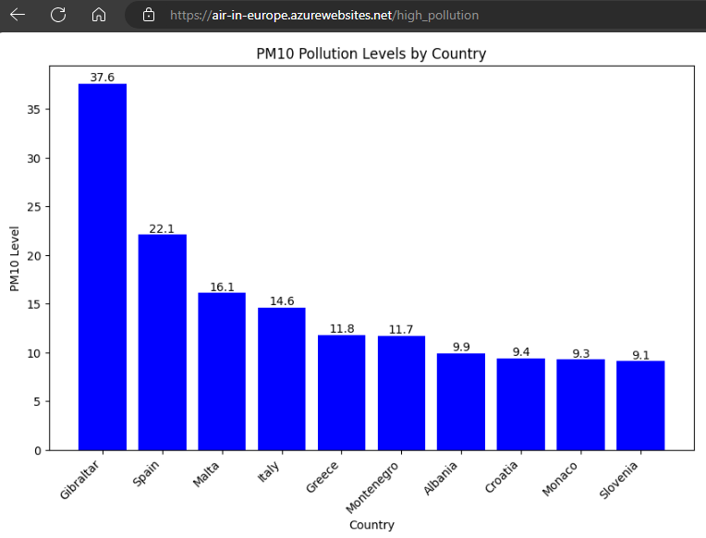
Analysis
Notes:
In my analysis phase, I’ve focused on identifying countries with the highest levels of PM10 pollution. Using Spark SQL, I've executed a query to calculate the average PM10 values by country, leveraging the data stored in the Delta table.
The result of this query is displayed in the bar chart here, which has been integrated into the web application deployed on Azure App Services. This visualization clearly shows the varying levels of PM10 across different European countries, with the Southern Countries having the highest average levels in this particular dataset.
It's important to note that the data for this chart is sourced from the serving layer, which I will show in the next slides. I've decided to maintain consistency in my presentation by focusing on the analytical outcomes before delving into the architectural details of the serving layer.
‘’

Slide 13
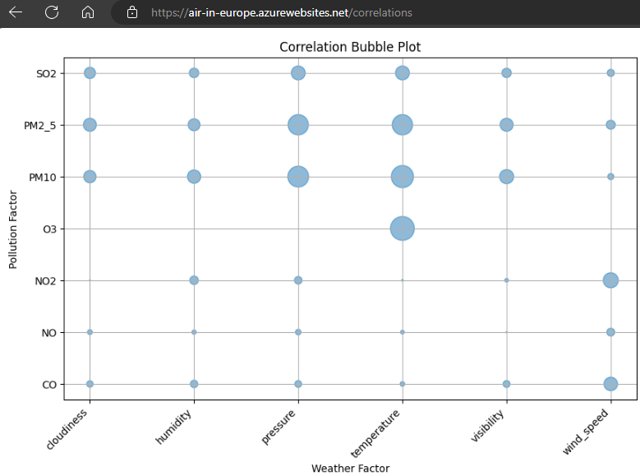
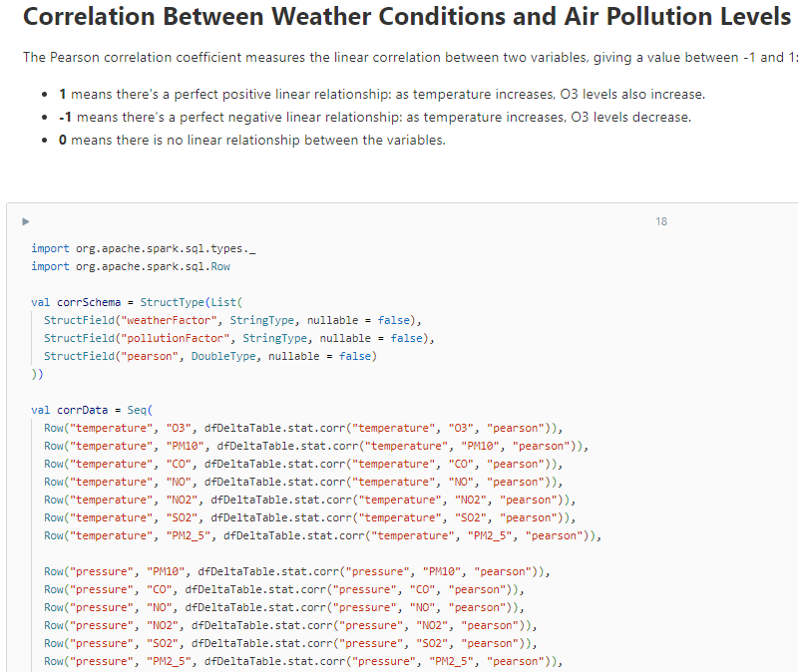
Analysis
…
Notes:
Here, I am examining the correlation between weather conditions and air pollution levels. The Pearson correlation coefficient is a statistical measure that I use to understand the strength of the relationship between two variables, ranging between -1 and 1.
For this analysis, I calculated the absolute values of the Pearson coefficients to illustrate the strength of correlations more effectively on our visualization.
The bubble plot you see here represents these correlations. For instance, we can observe whether higher temperatures correspond to higher levels of certain pollutants. This allows us to identify which weather factors are most closely associated with air pollution levels.
42‘’

Slide 14
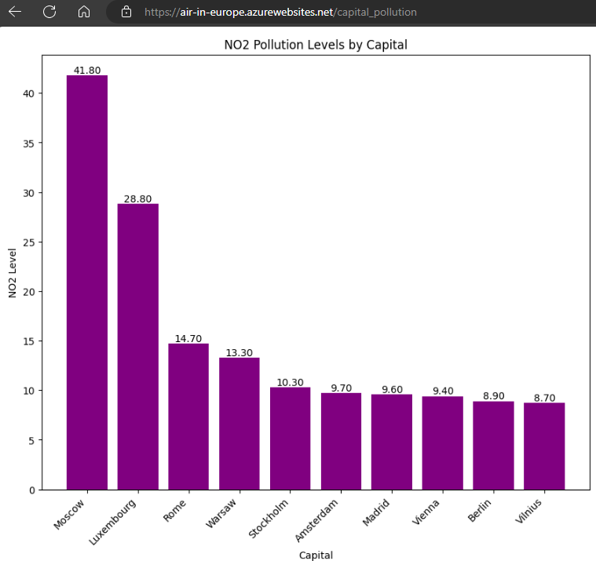
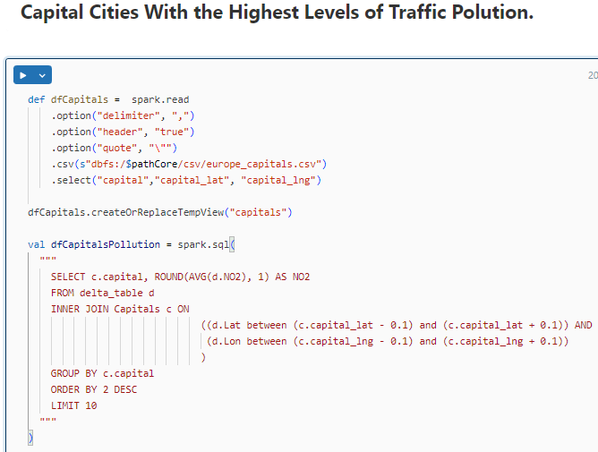
Analysis
Notes:
In this segment of my nalysis, I am pinpointing capital cities with the most significant traffic pollution, as indicated by levels of nitrogen dioxide, or NO2.
I've written a Spark SQL query that calculates the average NO2 concentrations by capital city. The query joins the pollution data with a list of capitals, considering their geographical coordinates to ensure accurate location matching.
The resulting bar chart, which is displayed on our Azure App Services-deployed web application, visualizes the NO2 pollution levels. It reveals that Moscow, Luxembourg, and Rome are currently the cities with the highest average NO2.
‘’

Slide 15
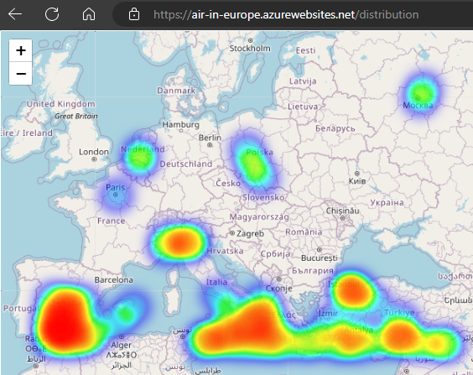
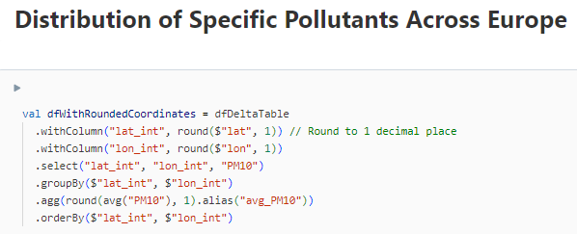
Analysis
Notes:
As part of my analysis, I've visualized the distribution of various pollutants across Europe, focusing on PM10 concentrations. The heatmap we see here was created using the Python Folium library, which is excellent for geographic data visualization.
The code snippet above transforms our data, rounding latitude and longitude to one decimal place to consolidate measurements into geographic grid points. Then, it aggregates the data to calculate average PM10 values for these points.
The result is this compelling heatmap. It highlights the areas with higher pollution levels in a more intense color, offering an immediate visual understanding of pollution distribution, which can be vital for environmental planning and policy-making.
41‘’

Slide 16
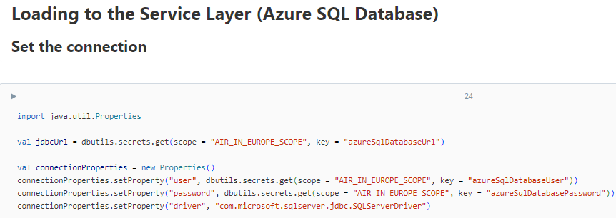
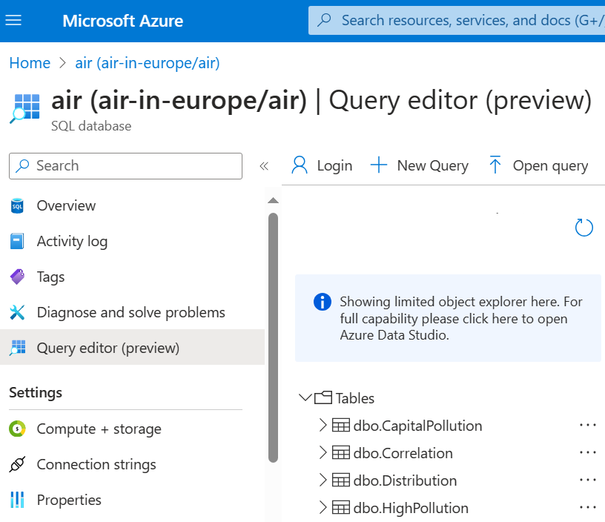
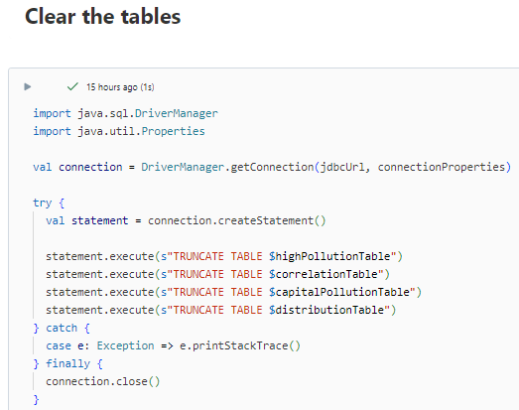
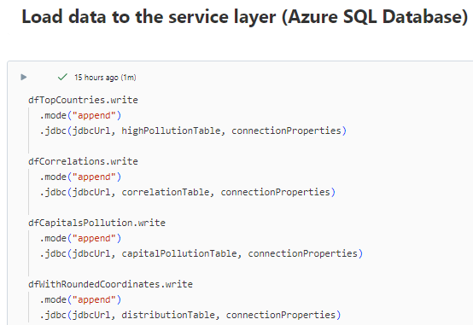
Serving Layer – Azure SQL Database
Notes:
We've now reached the Serving Layer of the modern data platform, where I use the Azure SQL Database. This critical layer is where our processed data becomes readily accessible for querying and visualization.
The code snippets here demonstrate two key operations:
First, I establish a secure connection to the Azure SQL Database, utilizing properties, retrieved from the secure Databricks scope .
Next, I ensure our tables are cleared for new data with the TRUNCATE TABLE SQL command, preparing the database for updated entries.
Then, we have the data loading process, where Spark writes the transformed and analyzed data into the SQL tables.
On the right, you see the Azure portal's interface, displaying the SQL database with its tables—ready for any applications connected to it.
This setup exemplifies how a cloud database can serve as a robust foundation as a service layer.
57‘’

Slide 17
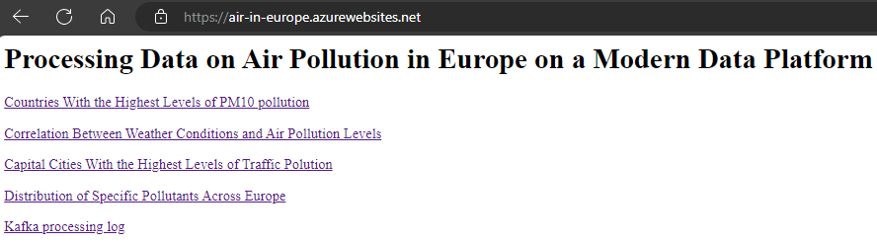
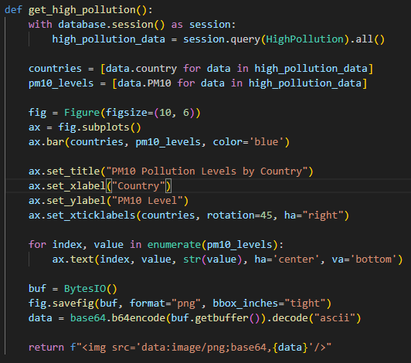
Serving Layer – Presentation in Azure Application
Notes:
Within the service layer, a crucial element is our Python application, designed to enhance user interaction and insight generation. This application leverages two powerful libraries: Matplotlib and Folium.
Matplotlib enables us to generate insightful visualizations, such as line plots, bar charts, and scatter plots, directly within our application.
Additionally, I use the Folium library to create interactive maps, as mentioned previously.
Summarizing, besides initiation of the pipeline, the Python application delivers comprehensive insights, combining statistical analysis with visual representation.
39’’

Slide 18
Conclusions
The use of a Modern Data Platform has revealed that the most polluted air is in Southern Europe.
Data Processing in Spark was very fast and efficient.
The analyses conducted were limited to only a portion of the processed data, so the results could be more diverse and interesting.
More information would be provided by comparing current data with historical data.
Specialized tools like Tableau can elevate the analysis.
Notes:
Concluding the presentation, let's reflect on the key findings and suggestions for improvement.
First, my analysis has revealed that Southern Europe has the most polluted air—a sobering realization that underscores the urgent need for targeted interventions in this region.
Data Processing in Spark was very fast and efficient, enabling me to handle large volumes of data with remarkable speed.
However, it's crucial to note that the analysis was limited to a subset of the available data. A more comprehensive analysis could yield a broader range of insights and potentially uncover hidden patterns and trends.
Furthermore, I want to highlight the importance of historical data, which was not analyzed in this study. Comparing our findings with past records could provide valuable context and a deeper understanding.
Lastly, I recommend the adoption of specialized tools like Tableau. Such platforms offer advanced features and capabilities that can elevate the analysis.
In conclusion, while my analysis has yielded valuable insights, there remains significant scope for further investigation and improvement. Thank you.
44’’

